Slide 1
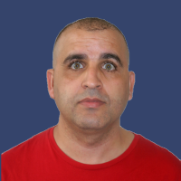
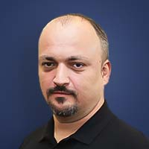
Peering Personal
IX Name | InterLAN-IX
City, Country | Bucharest, Arad, Cluj-Napoca, Constanta, Craiova, Iasi, Suceava, Targu Secuiesc, Timișoara – România Frankfurt – Germany Sofia - Bulgaria
Point of Presence | NXDATA-1 Bucharest NXDATA-2 Bucharest Voxility IRD Datacenter Bucharest Teletrans HB Bucharest Ines Datacenter M247 Europe Bucharest Radiocom Bucharest Equinix FR5 Frankfurt Telepoint Sofia
ASNs connected | 138
Peak traffic | 700 Gbps
Route Servers | Yes (BIRD v2 2.0.8)
RPKI (ROV) | Yes (MANRS)
Naoui
Eric
Alex

